Slide 1


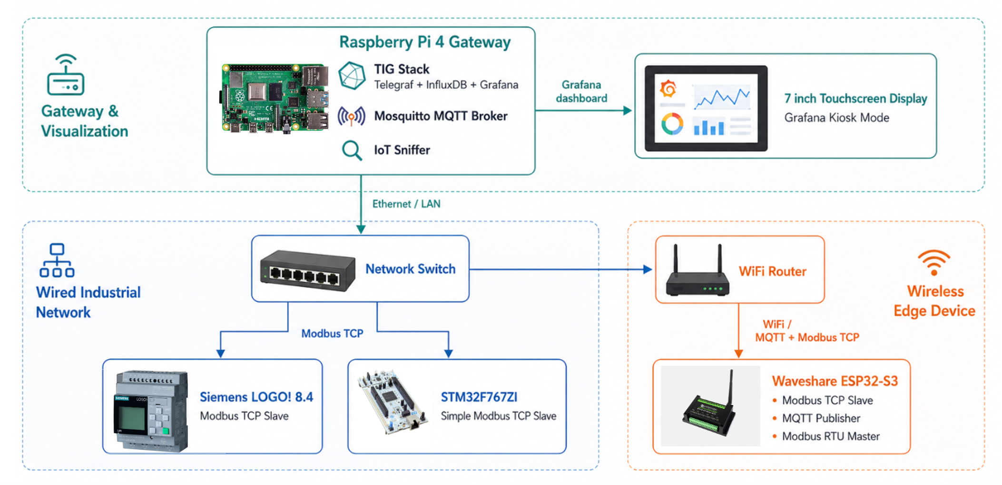
Design and Implementation of an Educational Industrial IoT Platform Combining SBC, MCU, and PLC
Patthanan Bhundhumani
Advisor: Dr.-Ing. Rawat Siriphokhapirom
s6301011610279@email.kmutnb.ac.th
Department of Electrical and Computer Engineering, Faculty of Engineering
King Mongkut's University of Technology North Bangkok, Bangkok, Thailand
Abstract
Analysis and Results
This work builds and evaluates a low-cost educational IIoT platform combining an MCU (ESP32-S3), an SBC (Raspberry Pi 4), and a PLC (Siemens LOGO! 24CE). On the MCU, a Modbus RTU-to-TCP/MQTT gateway bridges legacy serial field devices to modern IT systems; eight open-source ESP32 gateway libraries are benchmarked on real hardware for latency, throughput, and flash/RAM use to select one. Open-source software — Mosquitto, the TIG stack, and Node-RED — carries the IT and edge layers, while a passive IoT-Sniffer decodes Modbus TCP and MQTT on the wire for direct protocol visibility. Results show a single sub-2,000-THB microcontroller bridges legacy OT to an IT dashboard within its firmware budget, and the three controller classes prove complementary, not competing, teaching roles.
System architecture (below): the Raspberry Pi 4 (TIG stack + MQTT + IoT-Sniffer) bridges over Ethernet to a wired industrial network (PLC, Modbus TCP) and a wireless edge (ESP32-S3, MQTT + Modbus RTU master).
Introduction
Industry 4.0 pushes factories to expose shop-floor data to IT systems for monitoring and remote supervision, yet operational-technology (OT) equipment still speaks decades-old protocols. Modbus, introduced in 1979, remains one of the most widely deployed field protocols, and in its serial RTU form runs over RS-485 with no native path to an IP network. Replacing legacy field hardware outright is rarely economic, so the real problem is integration: lifting OT signals into IT dashboards at low cost without compromising the determinism OT depends on. Students entering the field must understand all three controller classes — MCU, SBC, and PLC — which differ not only in compute and I/O but in software ecosystem: the MCU and SBC run open-source toolchains (Arduino/PlatformIO, Linux/Docker), while the PLC is locked to a proprietary vendor toolchain. Commercial IIoT trainers are expensive and closed, hiding the wire-level behaviour learners need to see, and no empirical comparison guides which open-source Modbus library to use.
Table 1. FC03 round-trip latency, ESP32-S3, 100 registers, 9,600 baud (5 of 8 libraries benchmarked).
Library | Mean (ms) | Flash (KB) | RAM (KB) | Note
tobiasfaust (RTU) | 27.7 | 300 | 22.0 | Fastest
espressif/esp-modbus | 28.0 | 270 | 14.4 | Smallest RAM
eModbus/eModbus | 30.3 | 384 | 22.9 | FreeRTOS alt.
zivillian/eModbus | 32.9 | 384 | 22.9 | 132 ms outlier
emelianov/modbus-esp8266 | 33.4 | 310 | 22.2 | Recommended
Objectives
Design and build a low-cost educational IIoT platform integrating three controller classes: SBC (Raspberry Pi 4), MCU (ESP32-S3), and PLC (Siemens LOGO! 24CE).
Demonstrate IT/OT integration on an open-source stack — MQTT broker (Mosquitto), Node-RED, and the TIG stack (Telegraf, InfluxDB, Grafana) — as the edge and IT layers.
Implement a Modbus RTU-to-TCP/MQTT gateway on the MCU; benchmark open-source ESP32-S3 Modbus libraries on real hardware and measure the chosen gateway's latency, throughput, and flash/RAM use.
Develop an IoT-Sniffer that decodes Modbus TCP and MQTT on the wire to observe and measure the platform's network performance.
All 8 libraries passed the stress suite; every candidate sits within ~10 ms of the ~24 ms wire-time floor, well under the platform's 2-second telemetry cycle.
Built as a complete gateway — Modbus TCP slave, RTU master, MQTT publisher, and watchdog in one cooperative loop — the production firmware occupies 946 KB of the 1,310 KB app partition (72.2%) and 48.5 KB of 327.6 KB RAM (14.8%). End to end, an RTU poll, register update, MQTT publish, and TCP slave service complete well inside the two-second cycle, confirming a complete dual-protocol gateway fits a low-cost MCU with headroom to spare.
Conclusion and Contribution
Methodology
A single sub-2,000-THB microcontroller bridges legacy serial OT to an IT dashboard within its firmware budget (72% flash, 15% RAM). The MCU, SBC, and PLC prove complementary, not competing: the MCU suits the field-edge gateway, the SBC the data plane, and the PLC certified, deterministic control. Future work: add a telemetry ring buffer and OTA updates to the gateway; add InfluxDB backups, container health checks, and Grafana alerting to the IT layer; study OPC-UA for broader interoperability; and trial the platform with students in a laboratory course to assess its educational value before pursuing real deployment.
Overall architecture: the platform integrates the three controller classes on a single LAN. Field instruments — an XY-MD02 temperature/humidity sensor and an Eastron SDM230 power meter — are Modbus RTU slaves on an RS-485 bus. The Siemens LOGO! 24CE PLC performs deterministic control with industrial I/O; the ESP32-S3 edge gateway converts protocols; the Raspberry Pi 4 hosts the MQTT broker and the TIG data plane.
Two data paths run in parallel. Path A (direct Modbus TCP): any LAN host, including the PLC acting as master, polls a Modbus TCP server. Path B (telemetry pipeline): the ESP32-S3 polls the RTU sensors, publishes JSON over MQTT, and Telegraf ingests it into InfluxDB for display in Grafana.
Gateway timing budget (per cycle):
t(RTU poll) + t(MQTT publish) + t(TCP service) < 2,000 ms
The production firmware runs the chosen Modbus library as a TCP slave, a hand-rolled RTU master, an MQTT publisher, and a watchdog from one cooperative loop: 946 KB / 1,310 KB flash (72.2%) and 48.5 KB / 327.6 KB RAM (14.8%) — a complete dual-protocol gateway with headroom to spare.
Library selection: emelianov/modbus-esp8266 was chosen — the only actively maintained candidate offering RTU master, Modbus TCP slave, and multi-client TCP together (see Analysis and Results).
Concurrent firmware roles: each pass of the cooperative loop services a Modbus RTU master (polls the field sensors over RS-485 with CRC-16 framing, FC03/FC04), an MQTT publisher (serialises readings to JSON at QoS 1), a Modbus TCP slave (serves the same readings on port 502 as holding registers HR0–HR20), and a watchdog (forces a clean restart on a stalled cycle).
IoT-Sniffer: a passive Python protocol analyser verifies the gateway on the wire. It runs scapy's AsyncSniffer directly on the host NIC — no tap or port-mirror needed — and decodes Modbus TCP and MQTT at the application layer, reassembling out-of-order TCP segments and parsing the MBAP header and function codes to confirm every request/response pair matches firmware intent.
Related Courses :
Course ID
010113027
010113029
Course Name
MICROPRO & EMBEDDED COMP SYS
COMPUTER PROGRAMMING
References
[1] S. Santos, P. Costa, and A. Rocha, "IT/OT convergence in Industry 4.0: risks and analysis of the problems," in Proc. 18th Iberian Conf. on Information Systems and Technologies (CISTI), 2023.
[2] L. D. Xu, E. L. Xu, and L. Li, "Industry 4.0: state of the art and future trends," Int. J. Prod. Res., vol. 56, no. 8, pp. 2941-2962, 2018.
[3] Enterprise-Control System Integration - Part 1: Models and Terminology, ISA-95.00.01, 2010.
[4] Modbus Organization, Modbus Application Protocol Specification V1.1b3, 2012.
[5] Information technology - Message Queuing Telemetry Transport (MQTT) v3.1.1, ISO/IEC 20922, 2016.
[6] InfluxData, "Telegraf 1.28 documentation," 2024. [Online]. Available: https://docs.influxdata.com/telegraf/.
[7] InfluxData, "InfluxDB 2.7 documentation," 2024. [Online]. Available: https://docs.influxdata.com/influxdb/v2/.
[8] Grafana Labs, "Grafana documentation," 2024. [Online]. Available: https://grafana.com/docs/grafana/latest/.
Acknowledgement
The author thanks the project advisor, examination committee, and the ECE Department, KMUTNB, for their guidance and support.
Copyright © Department of Electrical and Computer Engineering, King Mongkut's University of Technology North Bangkok, Bangkok, Thailand
Academic Year : 2025

